Slide 1



Research Thesis Presentation
Forecasting Sri Lankan Tourist Arrivals
via Hybrid LSTM–XGBoost Ensemble Architectures Under Exogenous Shock Conditions
S M K I Wijethunga
Index No: KIC-BSCCSAI-251P-034
Notes:
Good morning. My project predicts tourist arrivals in Sri Lanka using a hybrid machine learning model and compares its performance during crises, like COVID-19 and the Easter attacks, with the current forecasting method.

Slide 2
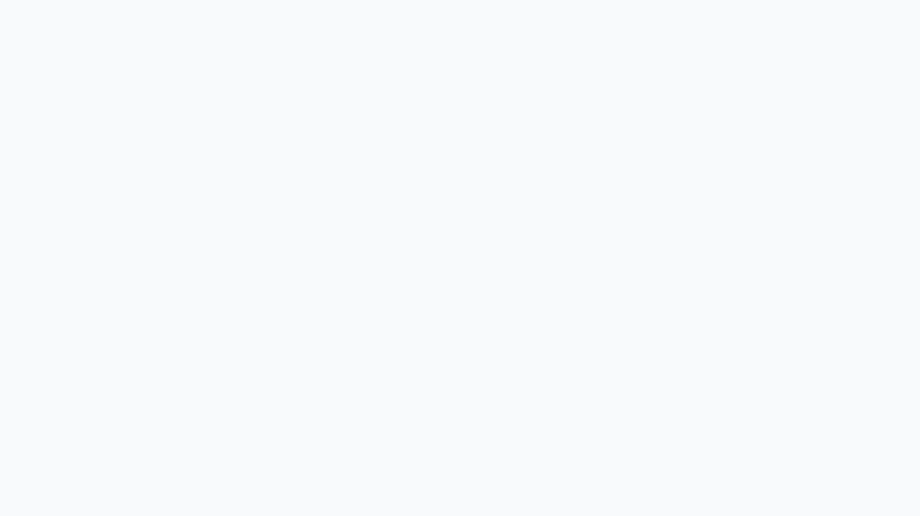
The Problem
Tourism is a major source of foreign income for Sri Lanka.
Hotels, transport, and businesses need accurate monthly forecasts to plan capacity, staff, and marketing
In the last decade, 3 major shocks disrupted arrivals:
  2019 Easter Sunday attacks
  2020–2021 COVID-19 pandemic
  2022 economic crisis
Current forecasting methods (SARIMA) work fine normally, but fail badly during these shocks
SHOCK-PERIOD DISRUPTIONS (2018–2023)
warning
2019
Easter Attacks
coronavirus
2020–21
COVID Pandemic
trending_down
2022
Economic Crisis
Notes:
Tourism is one of Sri Lanka's main sources of foreign income. However, events like the Easter attacks, COVID-19, and the economic crisis caused sudden drops in tourist arrivals. The current forecasting method, SARIMA, works well during normal times but is not very accurate during crisis periods because it relies on past patterns.

Slide 3
Research Problem & Gap
analytics
RESEARCH GAP 01
Multi-Period Validation
No locally-validated forecasting method has been systematically tested for both stable AND crisis-period accuracy in Sri Lanka.
layers
RESEARCH GAP 02
Ensemble Architects
No existing study has evaluated a stacked LSTM–XGBoost ensemble specifically on Sri Lankan tourist data.
Notes:
There is a gap in current research. No study has developed and tested a model for predicting Sri Lankan tourist arrivals during crisis periods. Also, no published research has combined LSTM and XGBoost for this purpose. This project aims to fill that gap by creating a more accurate forecasting model for Sri Lanka.

Slide 4
Research Question & Objectives
01
Compile and clean a tourism dataset (2015–2025) with exchange rate and search-trend features
RESEARCH QUESTION
The Core Inquiry
Does a hybrid LSTM–XGBoost ensemble forecast Sri Lankan tourist arrivals more accurately than SARIMA, both in stable and shock periods?
02
Implement SARIMA, standalone LSTM, and standalone XGBoost as baselines
03
Design a stacked hybrid LSTM–XGBoost ensemble
04
Evaluate all models on stable vs. shock periods using RMSE, MAE, MAPE and SHAP ect.
Notes:
My research question is simple: does combining LSTM and XGBoost predict tourist arrivals better than the current SARIMA method — both normally, and during crises?
To answer this, I have four objectives: first, build the dataset; second, develop the baseline models for comparison; third, build the hybrid model; and finally, evaluate the models for both stable and shock months using SHAP to explain the predictions.

Slide 5






Data Sources
Arrivals Data
SLTDA Reports (2015–2025)
Data Pipeline Details
Overview of integrated sources and parameters
Arrivals: Core dataset from SLTDA monthly tourist arrivals (2015–2025).
Currency: Monthly USD/LKR exchange rates from CBSL.
Search Trends: Google search volumes for key travel queries.
Methodology & Scope
Manually-labeled shock periods covering 2019, 2020–21, 2022.
Entirely public, secondary data with no human participants.
Exchange Rate
CBSL USD/LKR (monthly)
Central Database
Search Trends
Google Flights, Hotels, Visa
Notes:
All my data comes from public sources, with no surveys or participants involved. The main dataset is SLTDA monthly tourist arrival reports from 2015 onward. I also use Central Bank exchange rate data and Google Trends search data to improve the predictions. In addition, I marked the shock periods to evaluate the model separately.

Slide 6
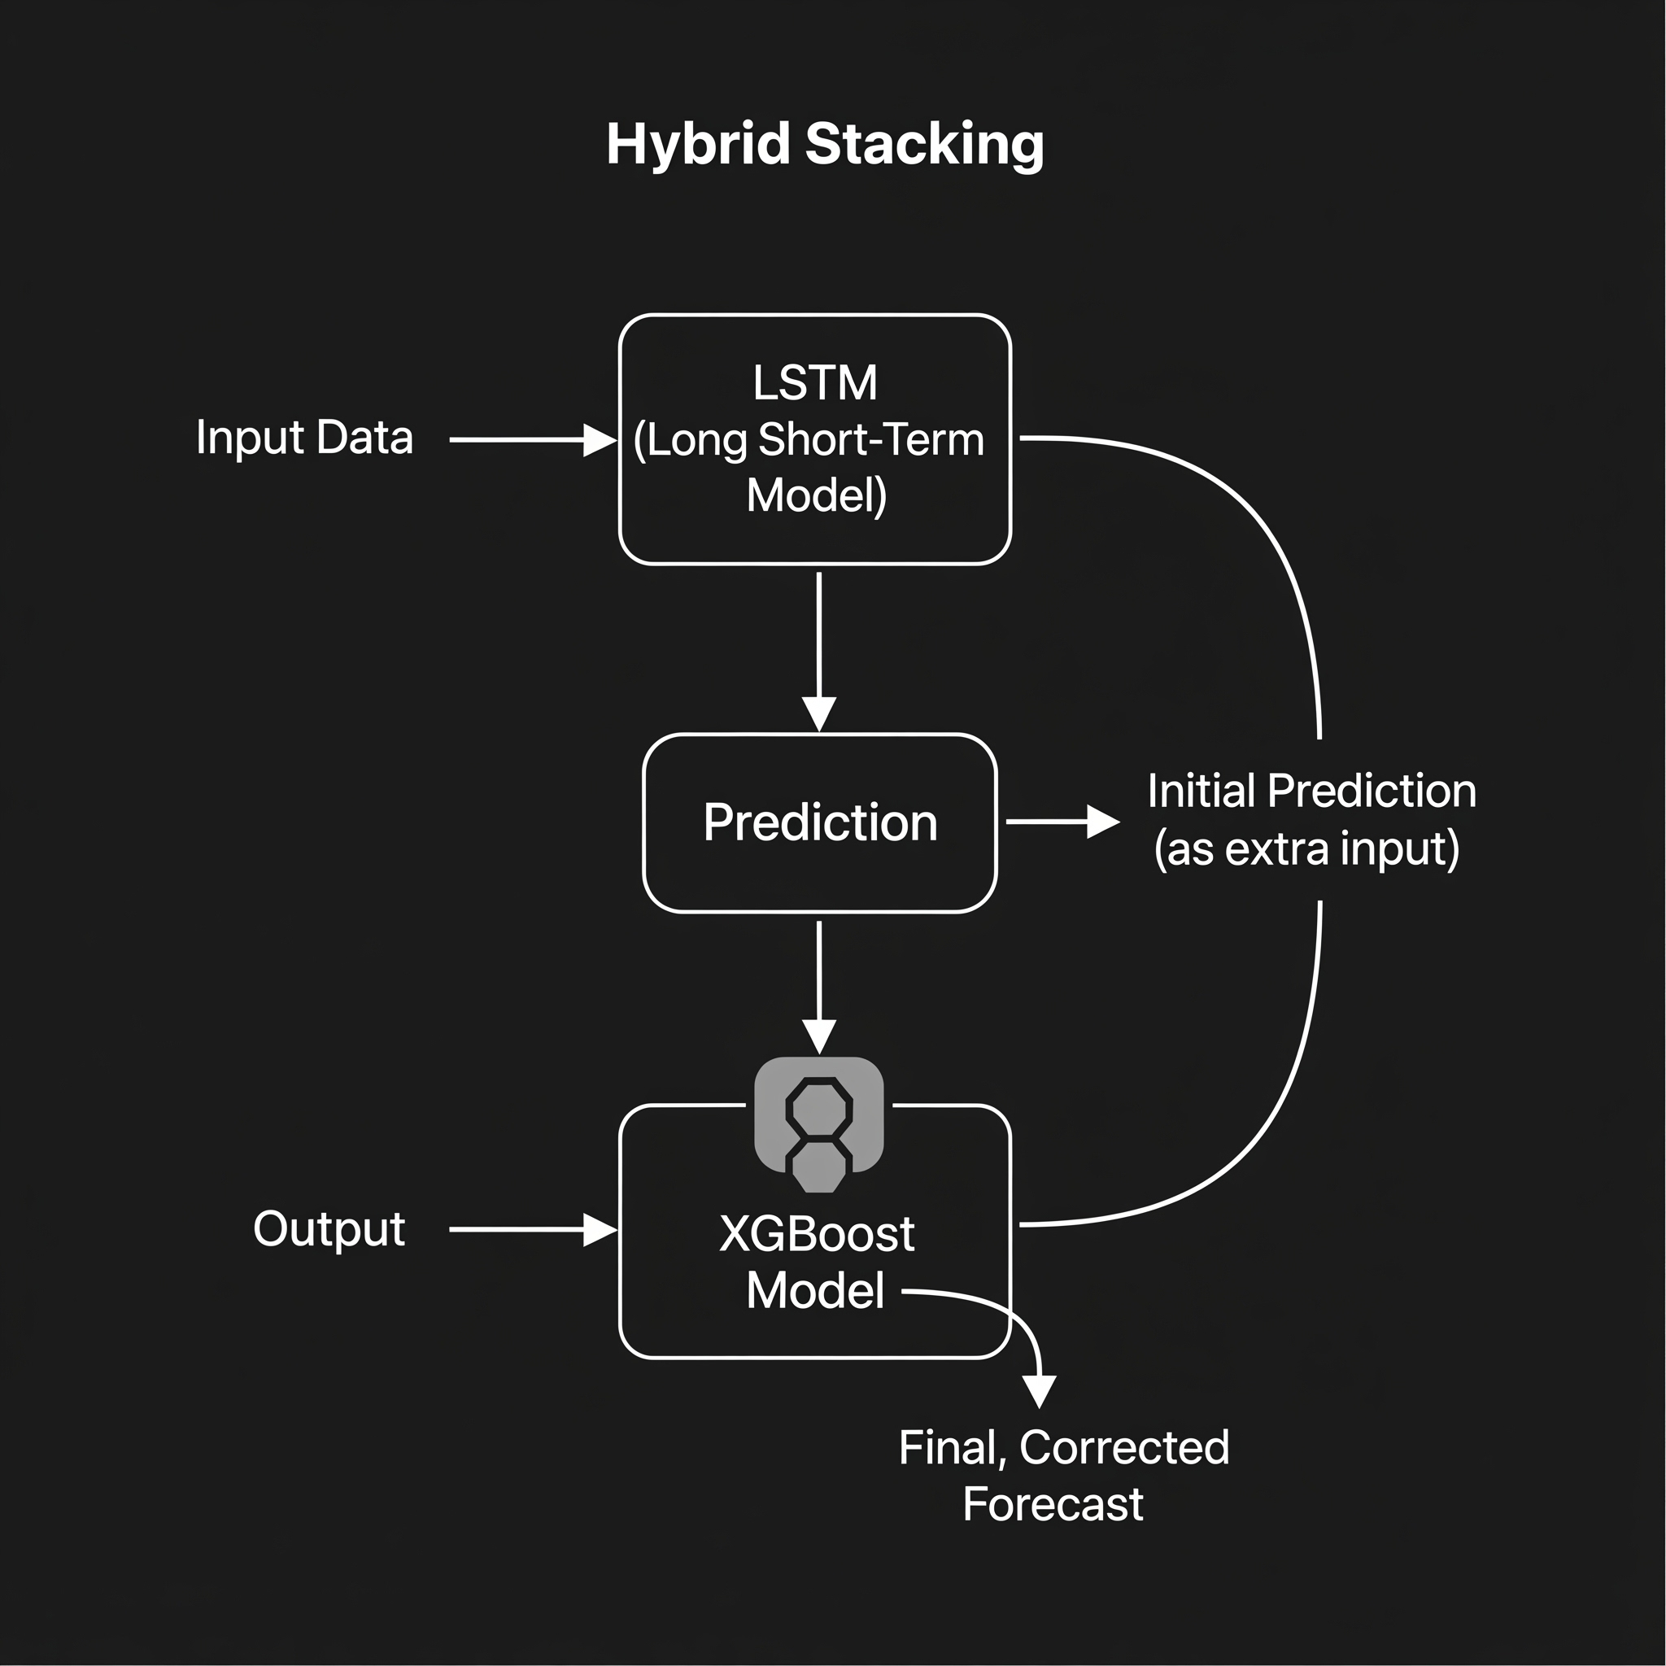
The Hybrid Model, Explained Simply
System Architecture
STAGE 1
LSTM
A neural network specialized in learning long-term seasonal patterns (e.g., December is always busier).
STAGE 2
XGBoost
Excellent at combining multiple diverse signals (exchange rates, search trends, shock flags) to catch complex relationships.
FINAL OUTPUT
Hybrid Stacking
LSTM makes an initial prediction → fed into XGBoost as extra input → XGBoost produces final, corrected forecast.
Notes:
My model combines LSTM and XGBoost. LSTM learns patterns over time, such as tourist arrivals increasing every December. XGBoost uses other factors like exchange rates, Google Trends, and crisis periods to improve the prediction. First, LSTM makes a prediction, then XGBoost adjusts it using the additional information to produce the final result.

Slide 7


Evaluation Method
Chronological split: train on 2015–2021, test on 2022–2025
Metrics: RMSE, MAE, MAPE — calculated separately for stable months vs. shock months
SHAP explainability — shows which features (exchange rate, search trends, shock flag) drive each prediction
STATISTICAL COMPARISON
Hybrid
SARIMA
Notes:
To test the models fairly, I trained them on older data and tested them on newer, unseen data, just like real-world forecasting. I will measure accuracy using three standard metrics for stable and shock months. I will also use the Diebold-Mariano test to verify whether the improvement is statistically significant, and SHAP to explain how the model makes its predictions.

Slide 8
Expected Outcomes
01. Tourism Dataset
A cleaned, reusable Sri Lankan tourism dataset with shock annotations.
02. Baseline Models
Working SARIMA, LSTM, and XGBoost baseline models.
03. Forecasting System
A functioning hybrid LSTM–XGBoost forecasting system.
04. Empirical Evidence
Statistically-tested evidence on whether hybrids outperform SARIMA — overall and during shocks.
05. Practical Value
Direct practical value to SLTDA, the Ministry of Tourism, and hospitality operators.
Notes:
By the end of this project, I expect to develop a hybrid forecasting model and show whether it performs better than the current method, especially during crisis periods. This research can also help SLTDA and tourism businesses improve their planning and decision-making.

Slide 9
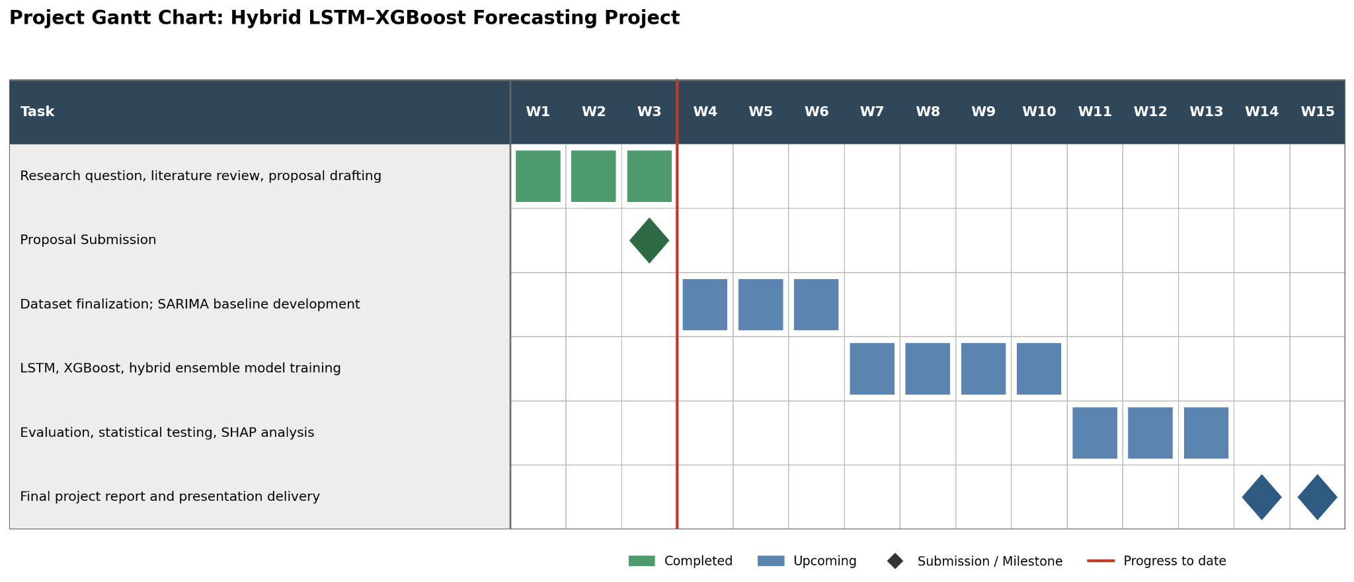
Project Timeline
WEEKS 1–3 (Completed)
Research question, literature review
PROJECT GANTT CHART: HYBRID LSTM-XGBOOST FORECASTING
WEEKS 4–6
Dataset finalization & SARIMA
WEEKS 7–10
LSTM, XGBoost & hybrid training
WEEKS 10–13
Evaluation, testing & SHAP analysis
WEEK 14–15
Final report & presentation delivery
Notes:
This is my project timeline. I have completed the first 3 weeks, including defining the research problem, reviewing the literature, and preparing the research proposal. The remaining 12 weeks will focus on developing the models, evaluating their performance, and completing the final report.

Slide 10






Thank you!
S M K I Wijethunga
KIC-BSCCSAI-251P-034
Notes:
Thank you

